Slide 1


Demoblaze Automation Project
By Chandrika David

Slide 2
1. Introduction
Overview of Demoblaze e-commerce website automation.
Built using Selenium WebDriver, TestNG, Cucumber, and Page Object Model (POM).
Objectives:
Automate login, signup, cart, and checkout.
Improve test efficiency using POM and Page Factory.
Implement data-driven testing with Excel (Apache POI).
Support parallel execution with TestNG XML.
Generate reports (Extent Reports, Allure Reports, Cucumber Reports).
Integrate with Jenkins for CI/CD.

Slide 3
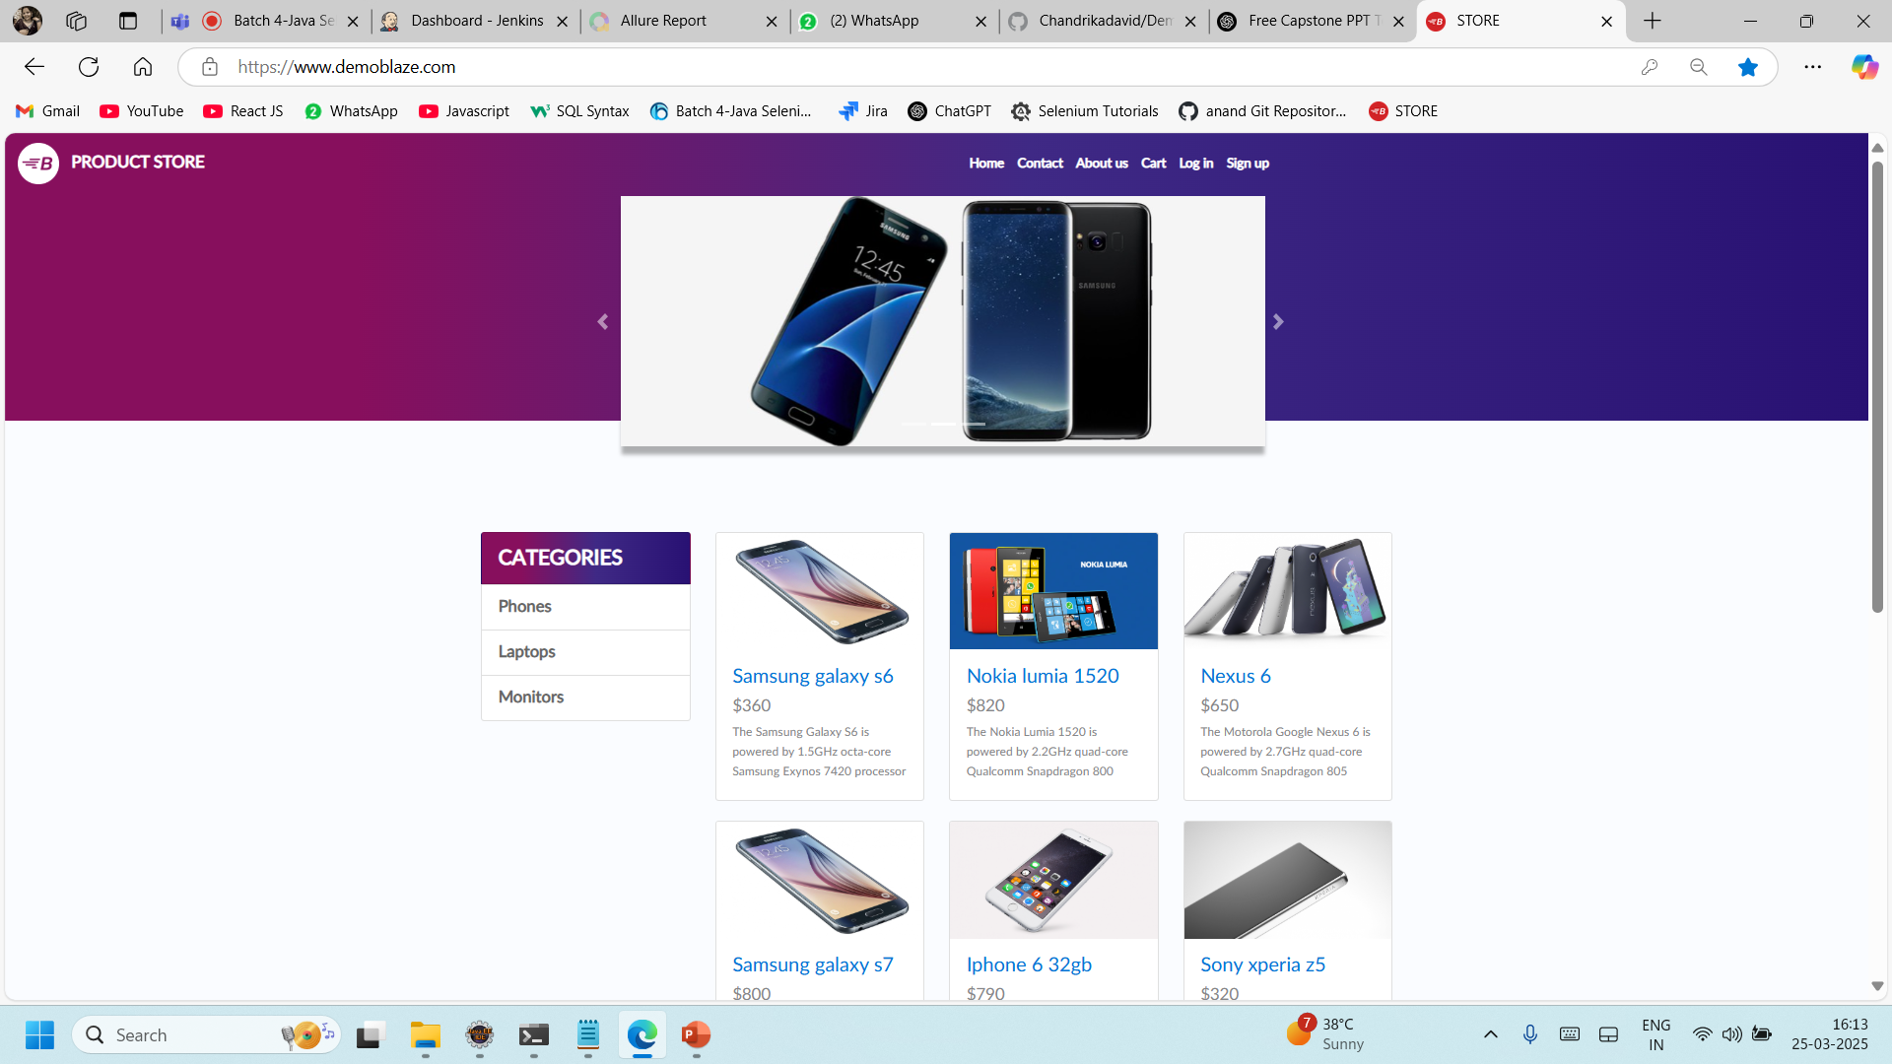
Demoblaze Home Page

Slide 4
2. Tools & Technologies Used
Programming Language: Java
Frameworks: Selenium WebDriver, TestNG, Cucumber
Data Handling: Apache POI (Excel), Properties files, Data Table.
Reporting: Extent Reports, Allure Reports, Cucumber Reports
Version Control: Git.
CI/CD: Jenkins

Slide 5
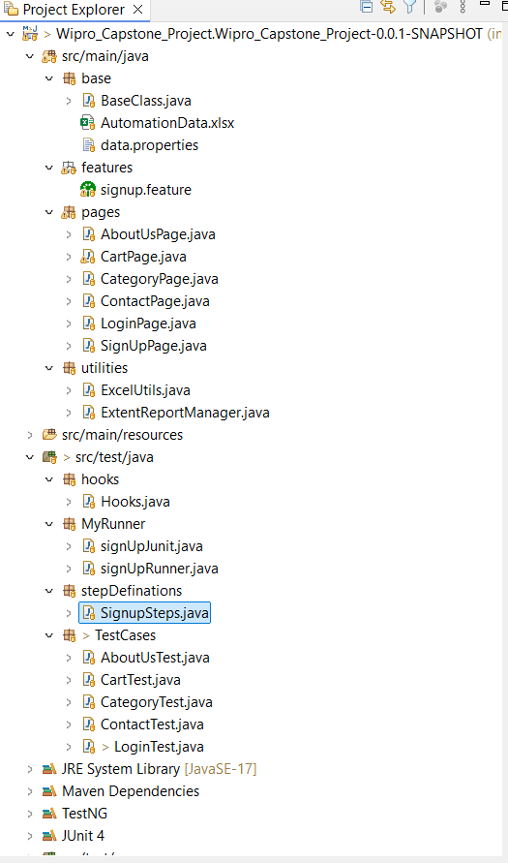
Test Automation Framework Structure

Slide 6
3. Project Structure
base/ - Contains BaseClass.java for browser setup, teardown, and data.properties and excel sheet for test data.
features/ - Holds Gherkin feature files (signup.feature implemented using BDD).
pages/ - Implements Page Object Model:
Signup Page: Uses BDD with Cucumber.
About Us, Contact, Category, and Login Pages: Use Page Factory (PF).
Cart Page: Uses POM without Page Factory.
utilities/ - Contains ExtentReportManager.java for test reporting.
hooks/ - Includes Hooks.java for test setup and teardown.
MyRunner/ - Contains Cucumber test runners (signUpRunner.java).
stepDefinitions/ - Step definitions mapping Gherkin steps to Java methods.
TestCases/ - Contains TestNG test classes for validation (LoginTest.java, etc.).

Slide 7
4. Key Features & Implementations
Login & Signup Automation:
Validate user authentication with valid and invalid credentials.
Data-driven testing with multiple inputs.
Cart & Checkout Operations:
Add multiple products from different categories.
Remove items from the cart.
Handle alerts and form submissions.
Reporting & Exception Handling:
Screenshots on test failures.
Detailed execution logs and reports.
Parallel Execution & Cross-Browser Testing:
Configured TestNG XML to run tests concurrently.
Jenkins integration with browser choice parameter.

Slide 8
5. Reporting Mechanism
Extent Reports – Generates visually rich HTML reports with detailed test execution status, logs, and screenshots.
Cucumber Reports – Provides structured feature-wise execution results for BDD scenarios.
Console Logs – Displays real-time test execution details for debugging and issue tracking.
Allure Reports – Offers interactive and graphical test execution insights, including step-wise details, history, and attachments.

Slide 9
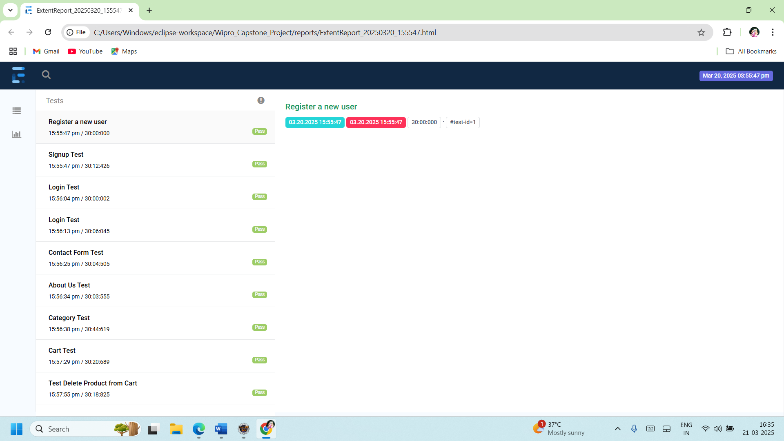
Extent reports

Slide 10
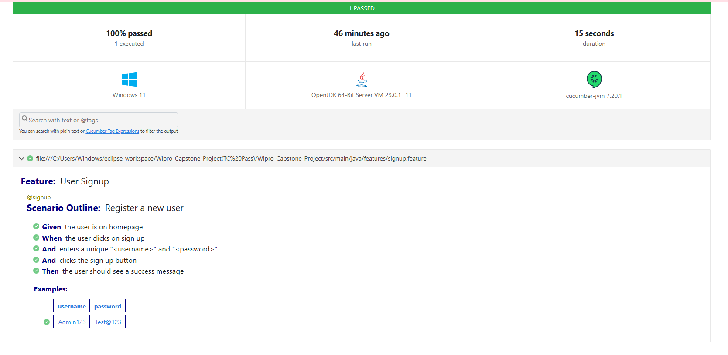
Cucumber reports

Slide 11
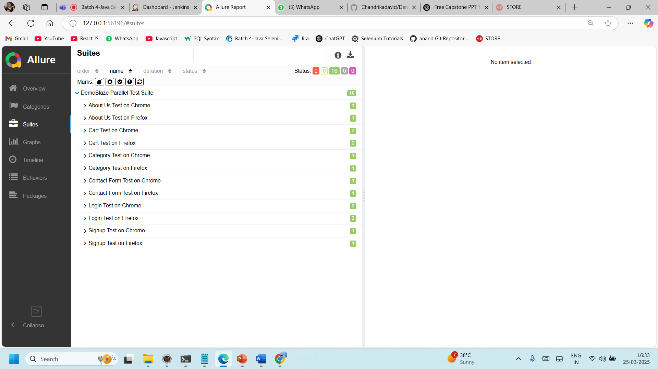
Allure Reports

Slide 12
6. Test Execution & Results
Test Scenarios Executed:
Login & Signup tests
Cart operations & checkout
Category navigation & alerts handling
Reports Generated:
Extent Reports for UI validation.
Cucumber Reports for feature-based execution.
Allure Reports for visual representation of results.

Slide 13
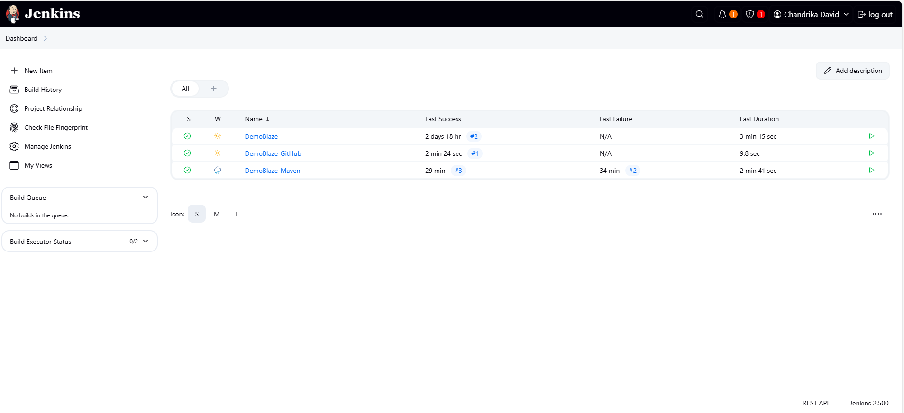
Jenkins Pipeline for CI/CD

Slide 14
7. Challenges & Learnings
Handling dynamic elements & synchronization issues.
Managing multiple test data sources efficiently.
Ensuring smooth Jenkins integration for CI/CD.

Slide 15
8. Conclusion & Future Enhancements
Expanding test coverage with API testing.
Implementing Docker for containerized test execution.
Enhancing reporting with custom dashboards.

Slide 16


